Slide 1
HP Kirchenchor pollham
© Lukas Knoll

Slide 2
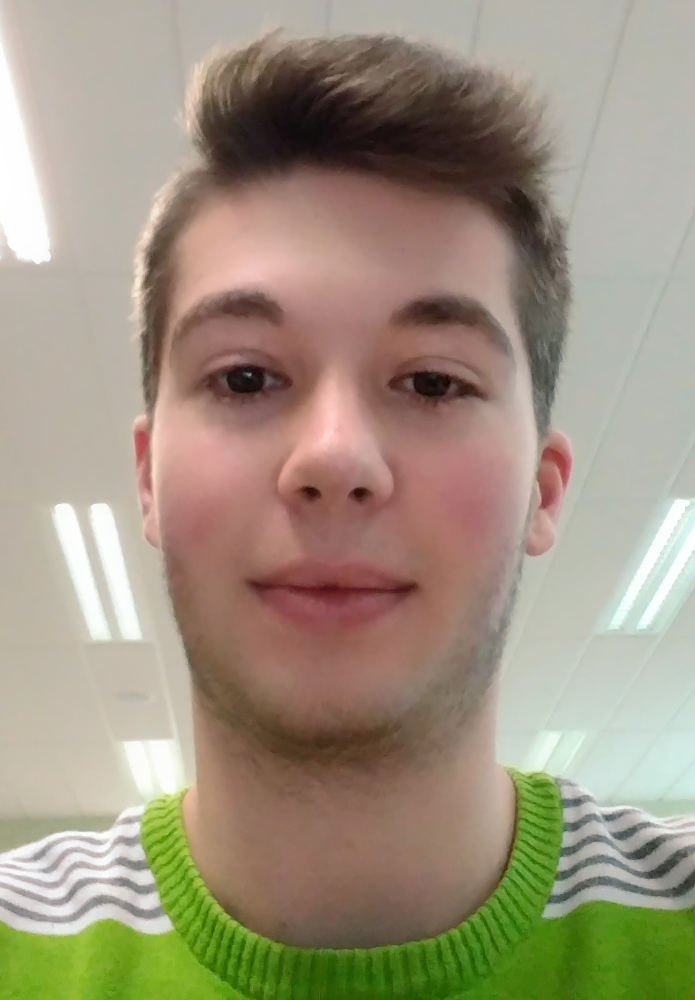
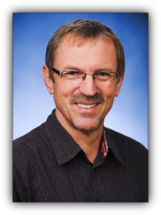
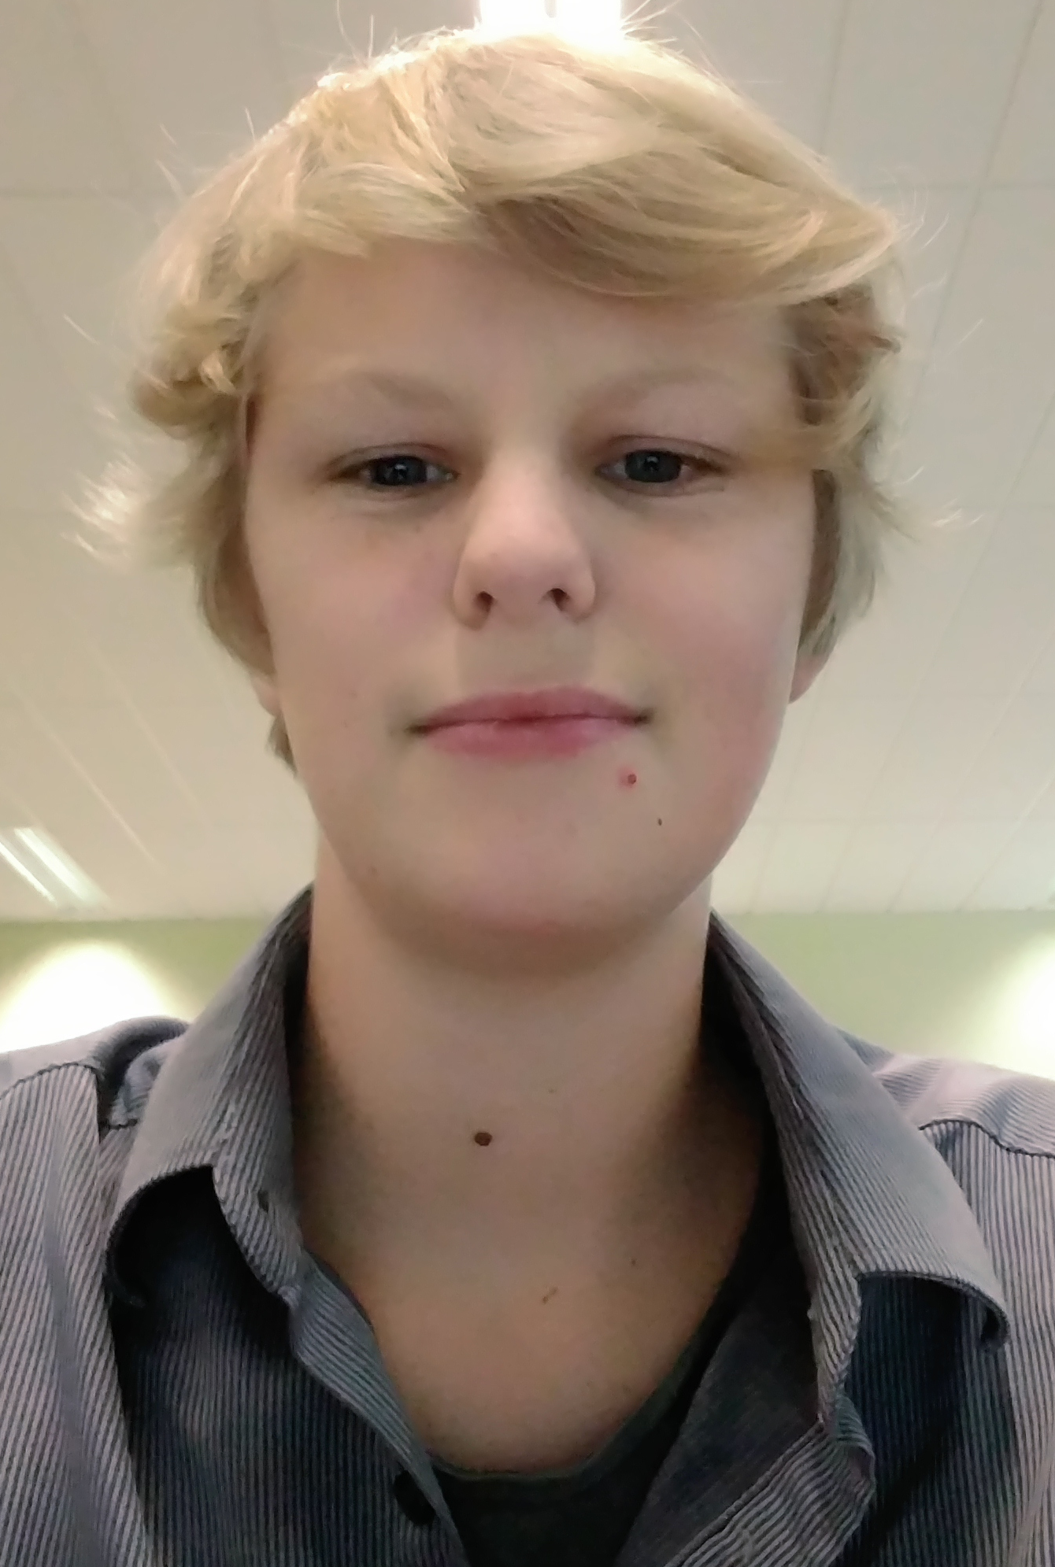
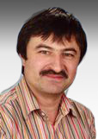
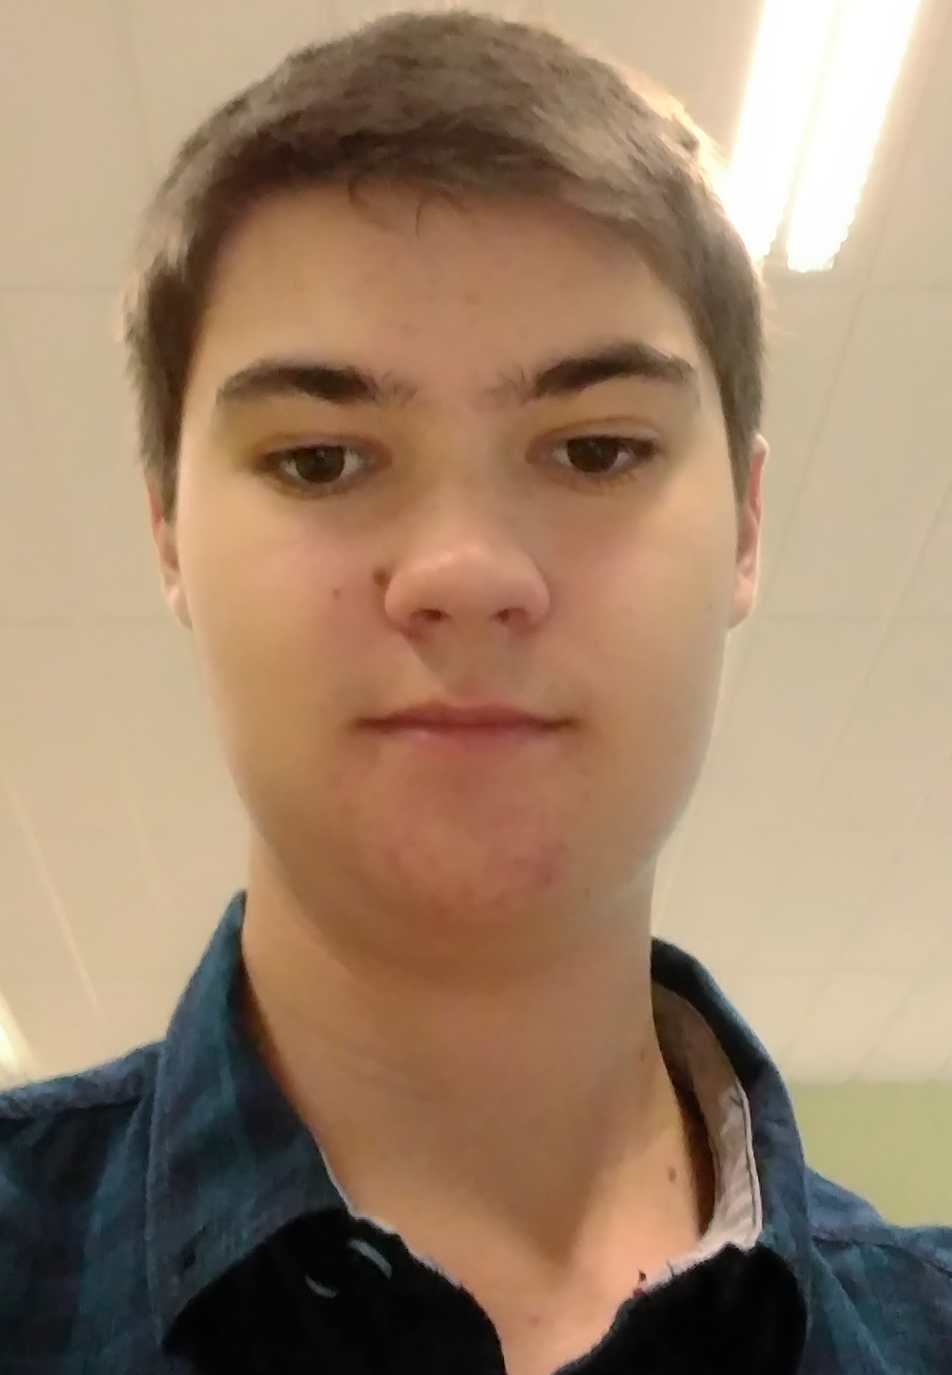
PRINCIPLE And Team:
Lukas Knoll (Project Manager)
Mag. Wolfgang Froschauer
(Customer)
Niklas Graf (Team Member)
DI Josef Doppelbauer
(Intermediary) Sebastian Mandl (Team Member)

Slide 3
The Problem:
No Event publication and official information source
No centralized storage solution for music notes
No online availability of music notes for choir members
It‘s a lot of work to inform all the members about the next training session – upcoming events

Slide 4
AIM:
Create a qualitative and representative Homepage
Public Area und Private Area
Administration of events through Google Calendar
Centralized Storage solution hosted by Google Drive
Displaying music notes and events depended on public and private areas

Slide 5
Solution:
Public area:
General information source for page visitors
Page visitors can check out and inform themselves about upcoming events
Private area:
Choir members access their music notes and become informed about upcoming events they have to train for ( + includes pure training-sessions).

Slide 6
StrategY:
Implementing the homepage and menus as described prior
Creating a database for storing and managing user data
(PostgreSQL-DB)
Using google libraries for the implementation of the calendars and additionally as a storage for media files
(Google Calendar, Google Drive, Google Docs)

Slide 7
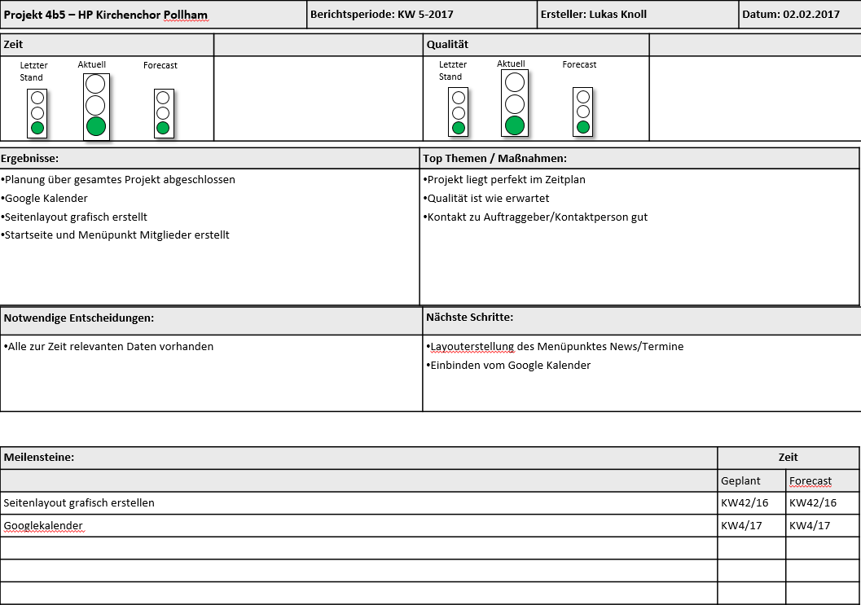

Slide 8
Basic Data and status:
Projectstart: 22.9.2016
Expected Projectend: 30.3.2016
Planned Workinghours: 254
Done Workinghours: 127
Projectclose through installation of the Homepage on a Webserver

Slide 9
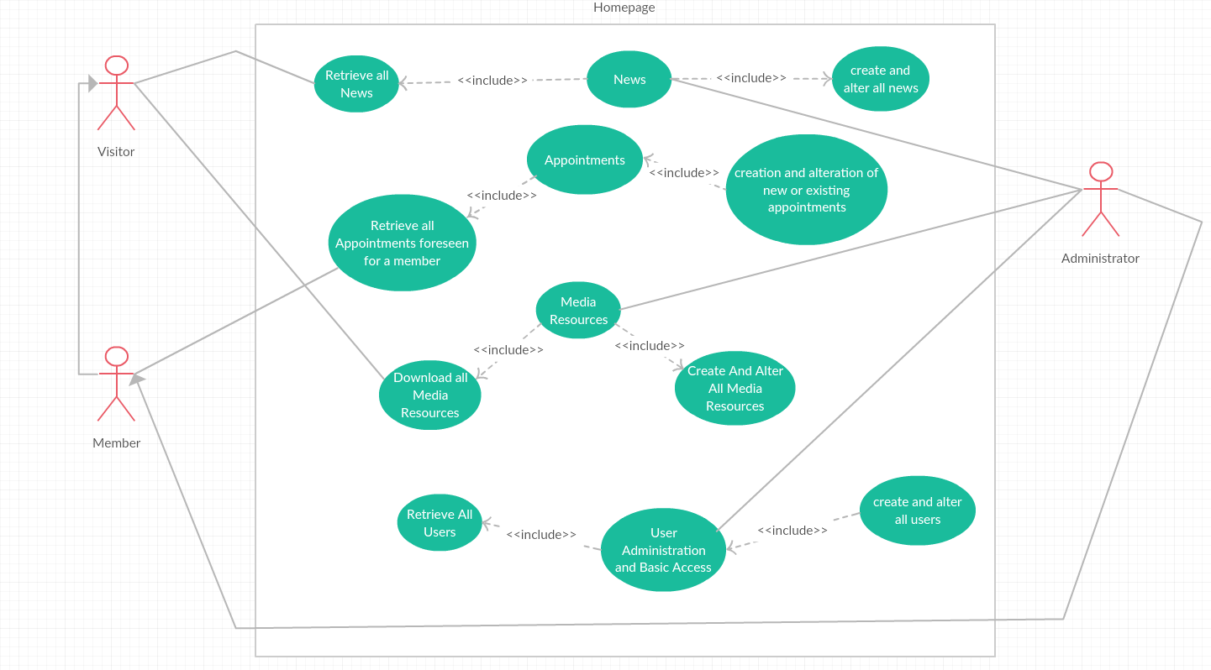

Slide 10
